Slide 1
A Place to Grow
cf.Objective() 2017
Marc Esher
@marcesher
https://marcesher.com

Slide 2
Building a Learning Organization
Notes:
Learning organizations:
Greater capacity to innovate, adapt, identify market opportunities, problem solve
problem solving capacity of the organization is improved through better access to knowledge and expertise
Let’s talk about building organizations that continually get smarter, by building stronger and stronger teams who make team and individual learning first-class citizens
I believe continuous learning is a CHOICE that organizations have. IT does not happen except through deliberately putting structures, processes, and habits into place to enable continuous learning

Slide 3
Lenses

Slide 4
Macro Lens: Multiplier Mindset

Slide 5
Lens: How team members treat one another
Psychological safety
Infectious curiosity

Slide 6
Lens: How teams are composed and tasks assigned
Diversity and Inclusion
In praise of maintenance

Slide 7
Lens: How products are built and run
Agile
Discovery & Feedback
The two most important questions
Retrospectives

Slide 8
Lens: How organizations respond to failure
Risk taking and learning from failure

Slide 9
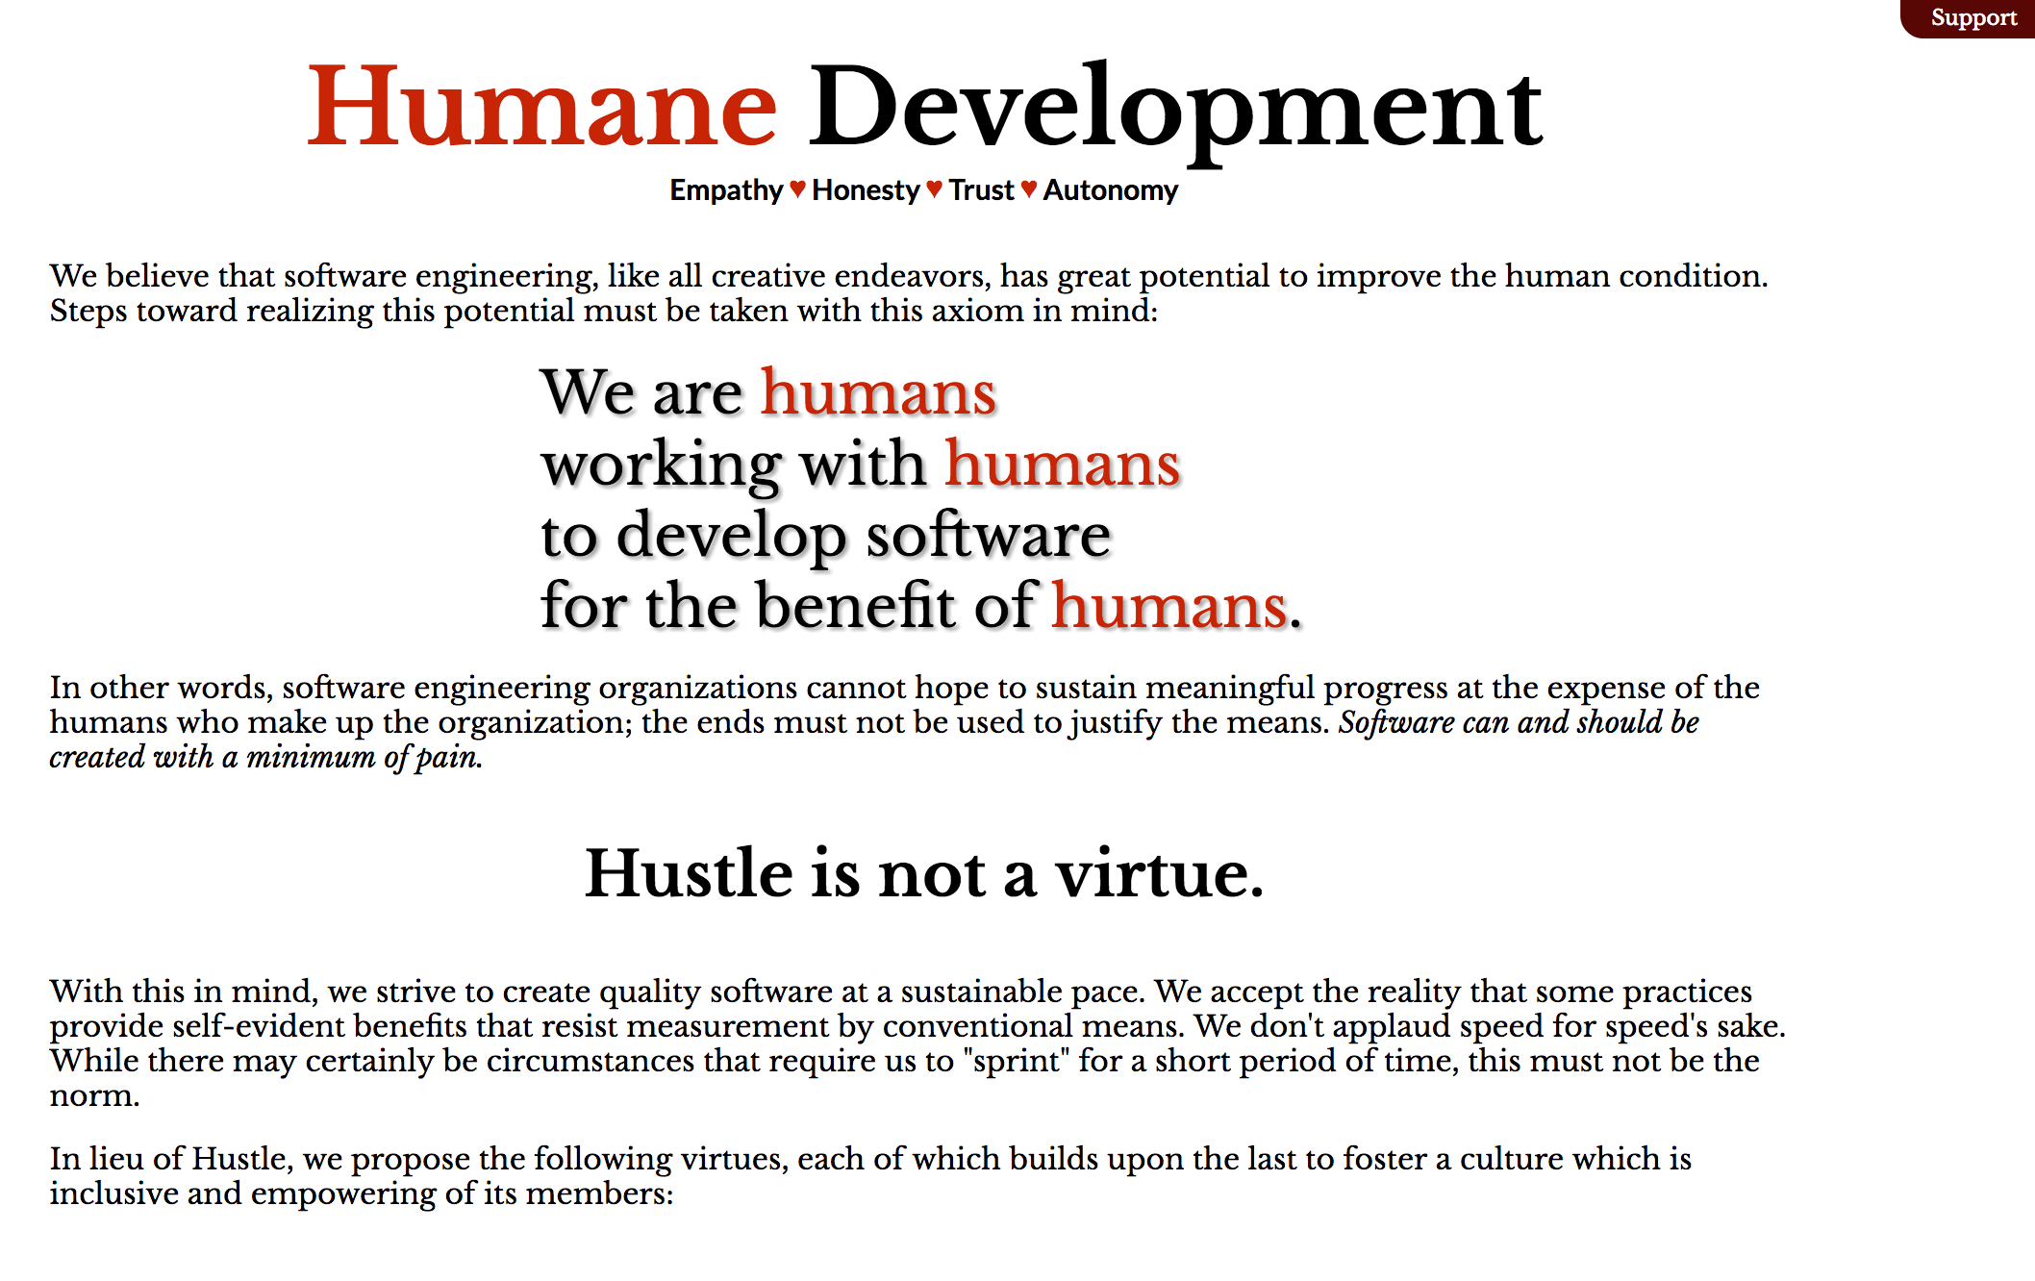
Humane Development
Ernie Miller

Slide 10
Multipliers vs. Diminishers

Slide 11


Slide 12
The Mindset of a Diminisher
“Really intelligent people are rare. They will never figure things out without me”

Slide 13
The Mindset of a Multiplier
“People are smart and will figure this out”
Notes:
Now, why are these mindsets so important?
Because just from these simple framings, SO MANY behaviors follow

Slide 14
Collective Intelligence
“Multipliers create collective, viral intelligence in their organizations”

Slide 15
A Diminisher…
May be a Genius, but doesn’t create geniuses
Stifles others’ intelligence
Depletes the organization of intelligence and capability

Slide 16
A Multiplier …
Is a “Genius Maker”
Brings out intelligence in others
Builds collective, viral intelligence in organizations

Slide 17
“Organizations are replete with underchallenged masses”

Slide 18
“People actually get smarter and more capable around them”

Slide 19
“They are accelerators to other people’s careers”

Slide 20
“The mind of the Multiplier works like this: If I can find someone’s genius, I can put them to work”

Slide 21
“What do they do better than anything else they do? What do they do better than the people around them? What do they do without effort? What do they do without being asked? What do they do readily without being paid?”

Slide 22
“Fish discover water last”

Slide 23
A Multiplier Is…
A Talent Magnet
A Liberator
A Challenger
A Debate Maker
An Investor

Slide 24
A Diminisher Is…
An Empire Builder
A Tyrant
A Know-It-All
A Decision Maker
A Micro Manager

Slide 25
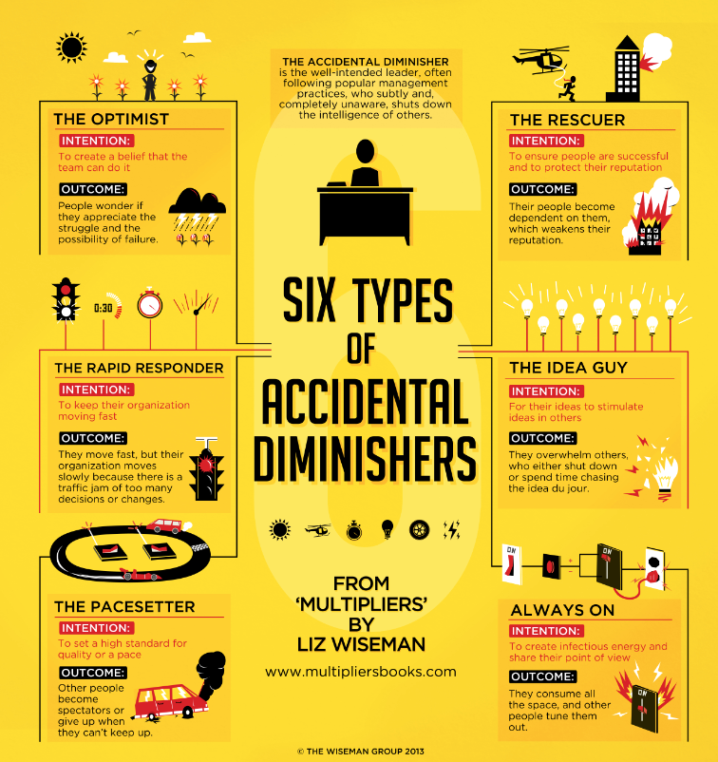

Slide 26
Story time: Multipliers in Action
Notes:
My first day at argus
Joe’s User Object
Bill’s “wires hanging out” story
Dev / Clojure story
DevDash Failure story
Irina Alert Audit
Tell some Diminisher stories
“Here’s what we’re going to do” – an executive who wanted to micromanage
My own team telling me: stop fixing all the broken servers! Stop responding to incidents
Honestly, even one I’m kind of struggling with right now is setting direction vs ensuring the direction gets set. I’m kind of a control freak with my team’s roadmap and I need to do a better job of involving the team in direction setting… when I look back over the past few years I can see a pattern where this ebbs and flows with me. There are times when I’ve been really good about this, and now I feel like I’m not being so good.
On your flight home….

Slide 27
Silent Killers Know-it-all-ness Do-it-all-ness

Slide 28
My 3 Wishes
Notes:
- When people ask you for help, try to teach them how to find the answers for themselves. Don’t immediately jump to solve their problem. Teach them how to solve that problem. Give them just the next thing they need
If you are going to someone with a problem, try to identify what you’ve already done to solve the problem and what you think you need to know next
Managers: support this behavior

Slide 29
How Team Members Treat One Another

Slide 30
“Psychological Safety”
Dr. Amy Edmondson
Notes:
August 6, 1997, Korean Air Flight 801
Descending to land in Guam, and a few seconds later, splat into a hill that was a few miles short of the runway. 228 of 254 souls lost.
Investigators later determined that one contributing factor to the crash was that while the co-pilot and flight engineer spoke up a little bit that they thought something was wrong, because Korean culture emphasizes authority so much, they ultimately didn’t feel comfortable speaking up strongly enough. They gave hints, but were not direct.
I should say that since the late 90s, Korean Air has had a stellar safety record because of their efforts to learn from crashes such as this. They changed the flight language from Korean to English so that pilots could have a kind of 2nd persona in the cockpit, giving them more confidence and assurance that it’s OK to be direct
This isn’t about Korean culture. It’s about power structures. Let’s fast forward a few years to the early 2000s, in a Rhode Island Hospital.
Its Intensive Care Unit was labeled as one of the finest in the country, but tensions between nurses and doctors were simmering and about to boil over. It was described as a “glass factory”, because it felt like it was all going to come crashing down at any moment.
In one case, an 86 year old man falls at his house and whacks his head. He has a subdermal hemotoma.
Heads to that hospital and ER staff say that he needs to have his brain pressure relieved or he’ll die.
They page the neurosurgeon on duty. Soon, the 86 yo man is on the operating table.
The nurse says that the location of the hematoma isn’t listed on the consent form. None of the paperwork that accompanied the man indicates what side of the brain the hematoma is on.
The nurse suggests they pull up the films.
The surgeon insists he’s seen the films, knows what side it’s on, and that the procedure begin immediately.
The nurse pushes back and suggests pulling up the films again.
The surgeon says we don’t have time. The nurse suggests that they consult the family.
The surgeon says do what you want, but I’m going to save this man’s life.
The nurse relents.
The surgeon starts sawing skull. He does his thing with the saw and pops part of the skull off.
“Oh my God”, someone says.
No hematoma.
They had sawed off this old guy’s skull on the wrong side.
He dies 2 weeks later.

Slide 31
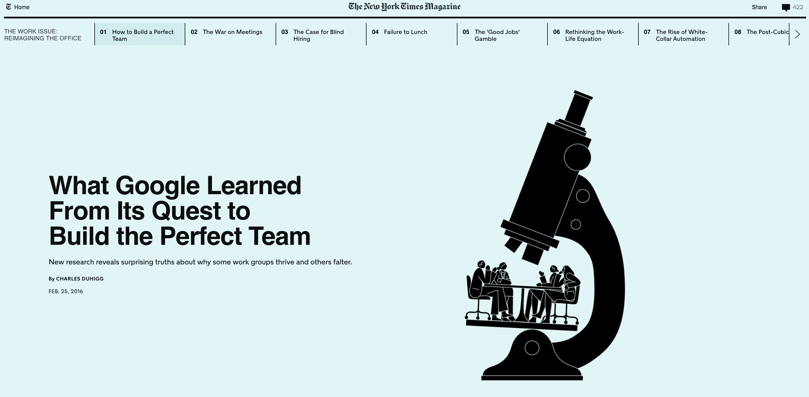

Slide 32
Questionnaire
If you make a mistake on this team, it is often held against you.
Members of this team are able to bring up problems and tough issues.
People on this team sometimes reject others for being different.
It is safe to take a risk on this team.
It is difficult to ask other members of this team for help.
No one on this team would deliberately act in a way that undermines my efforts.
Working with members of this team, my unique skills and talents are valued and utilized.
https://rework.withgoogle.com/guides/understanding-team-effectiveness/steps/foster-psychological-safety/

Slide 33
3 Simple Things You Can Do
Frame the work as a learning problem, not an execution problem.
Acknowledge your own fallibility.
Model curiosity and ask lots of questions.
https://rework.withgoogle.com/guides/understanding-team-effectiveness/steps/foster-psychological-safety/
Notes:
Framing the work as a learning problem:
Recognize that there is enormous uncertainty and enormous interdependence. We’ve never been here before. We don’t know what will happen. Recognize that we have to have everyone’s brains and voices in the game.
“that creates the rationale for speaking up”
- these are Dr. Edmondson’s words. https://rework.withgoogle.com/guides/understanding-team-effectiveness/steps/foster-psychological-safety/

Slide 34
Infectious Curiosity

Slide 35
“I wonder…”
“What if?”

Slide 36
“I don’t know”

Slide 37
“What are the tradeoffs?”
“What do you think?”

Slide 38
“How did you figure that out?”

Slide 39
Vocalize your curiosity!

Slide 40
How Teams are Composed and Tasks Assigned

Slide 41
Diversity & Inclusion

Slide 42
D&I are moral imperatives

Slide 43
D&I are business imperatives

Slide 44
Recruiting

Slide 45
Interviewing

Slide 46
Attention

Slide 47
Opportunity

Slide 48
“In Praise of Maintenance”

Slide 49
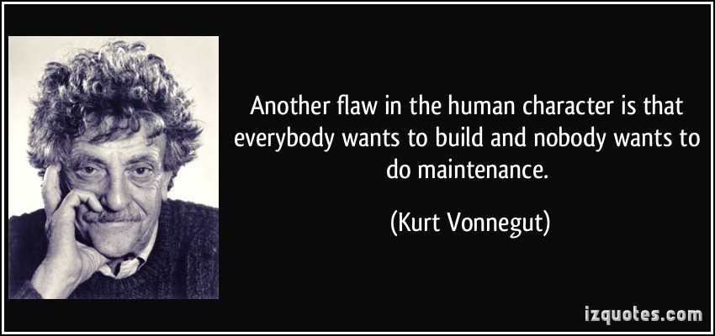
http://izquotes.com/quotes-pictures/quote-another-flaw-in-the-human-character-is-that-everybody-wants-to-build-and-nobody-wants-to-do-kurt-vonnegut-275976.jpg

Slide 50
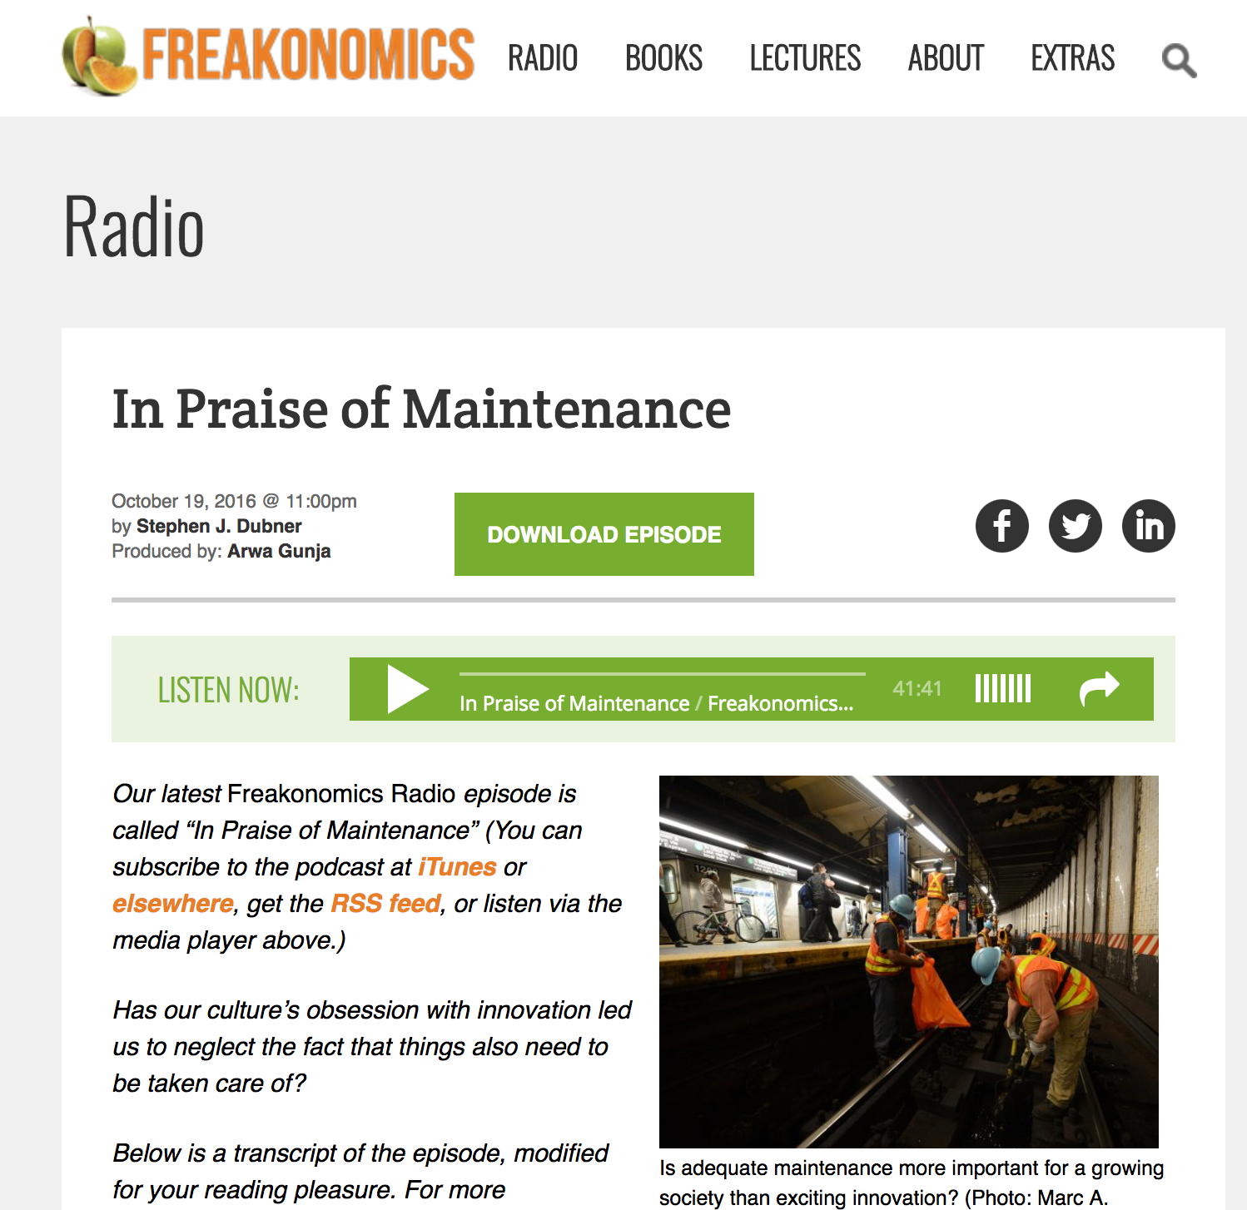

Slide 51
Learning is nearly always Uncomfortable

Slide 52
Maintaining others’ software can be Deeply Uncomfortable

Slide 53
Developers cripple themselves when they don’t embrace this discomfort
Notes:
“All Greenfield” development is an anti-pattern, but it is so attractive to just build new things because you can keep the entire system in your head
You learn so much by fixing broken things, especially things that others have built
Read lots of other peoples’ code, open source libraries, etc
Develop a habit of going to the code for answers
Look out for the same few people fixing the broken things, especially if they’re the people who built the system
Jessica Kerr’s post: if you have one or two people who know the system intimately but everyone else is wary of it, that’s a huge bus problem
Organization must understand that to solve that bus problem, the other devs are going to be much, much, much slower when poking around in that system
But the only way to fix that is to trade off efficiency/productivity for learning.
This is just another example of Multiplier behavior in action.
In systems where one or two people know all the things, they can either just fix things – which is productive – or they can be multipliers and grow the collective intelligence of their teams by helping the other devs learn how to maintain the system
When I look back on my career, some of my greatest mistakes were when I built green-field systems, not working harder to invite and teach other developers how to maintain them. I was a bus problem but I didn’t understand how big a problem that was.
I should’ve been doing the work of finding opportunities to have others contribute, help them contribute, help build confidence. In short, I should have invested energy in helping the team be able to maintain that software.
I once had a boss tell me: “you’re too big to fail”. This was right after the 2008 crash and that phrase was popular. Now, initially, I took that as a compliment. Like, I had made myself indispensable.
On reflecting, though, while it boosted my ego, that meant there was a lot of growth left on the table for the team.
So: if you typically only do greenfield development, I strongly encourage you to find opportunities to work on other people’s software. Demand it from your managers. Or go find open source projects to contribute to.
If you’re a manager or a person who is a sole maintainer of a complex system, I strongly encourage you to find opportunities to bring other team members into your world. Be patient with them. Understand they have none of the context you have. Nothing will be easy for them! Don’t tell them it will be. Assure them that you know it’s hard but you also know you’re there to help and guide. Remember: you’re building your team’s collective intelligence by growing each individual up.

Slide 54
How Products are Built and Run

Slide 55
Agile really is all about Learning

Slide 56
“Discovery” phases are about Reducing Uncertainty

Slide 57
The 2 most important questions:
Are we building the right thing?
How do we know that?

Slide 58
The most important ceremony is the Retrospective

Slide 59
How Organizations Respond to Failure

Slide 60
Learning from Failure

Slide 61
3:52 AM: Uh-oh
Notes:
I’m going to tell you a story about a time when our public data platform went down and became inaccessible to the public
AWS sends alert indicating the website is down

Slide 62
3:53 AM: Definitely Uh-oh
Notes:
Another production monitor sends alert that all PDP web servers are down

Slide 63
4:05 AM: Yoohoo… still uh-oh
Notes:
3rd monitoring system lets us know that, yup, nothing is working

Slide 64
7:16 AM: First responder
Notes:
A sysadmin tries to diagnose and troubleshoot and is unsuccessful. Emails small group of people in SE and dev

Slide 65
7:25 AM: Cavalry
Notes:
Marc responds to that small group, adding a bunch more people. Starts investigating as well.

Slide 66
7:46 AM: Bat signal
Notes:
Marc responds to everyone again, asking everyone for help

Slide 67
8:00 AM: First phone call
Notes:
Marc calls Keith. Learns another sysadmin has started to investigate

Slide 68
8:10 AM: Bridge call… battlestations!
Notes:
We start up a conference call and ask everyone to join in

Slide 69
8:15 to 8:30 AM: A-ha!

Slide 70
8:30 to 9 AM: Fix rolled out

Slide 71
9:11 AM: All monitoring systems OK

Slide 72
@5 hours total time to recover

Slide 73
@2 hours from first response to recovery

Slide 74
@1 hour to recover after swarming

Slide 75
@30 minutes to recover after discovery
Notes:
Not Great

Slide 76

http://lifeisaforkintheroad.com/wp-content/uploads/2013/07/Fork-In-Forest-darker.jpg
Notes:
http://lifeisaforkintheroad.com/
Now, what happens next is the entire point of this section.
2 choices:
Problem is fixed… just move on
Learn and improve the system

Slide 77
“Blameless post-mortems”
Notes:
What we have been doing – in concert with the linux sysadmins in Systems Engineering and the Delivery team team, in our AWS environment, is something that Etsy calls “Blameless post-mortems”
Now, here, we don’t actually talk about it that way. If you were to ask a sysadmin in SE about it, he wouldn’t say “oh, yeah, we do what Etsy does”. But that is what we do.

Slide 78
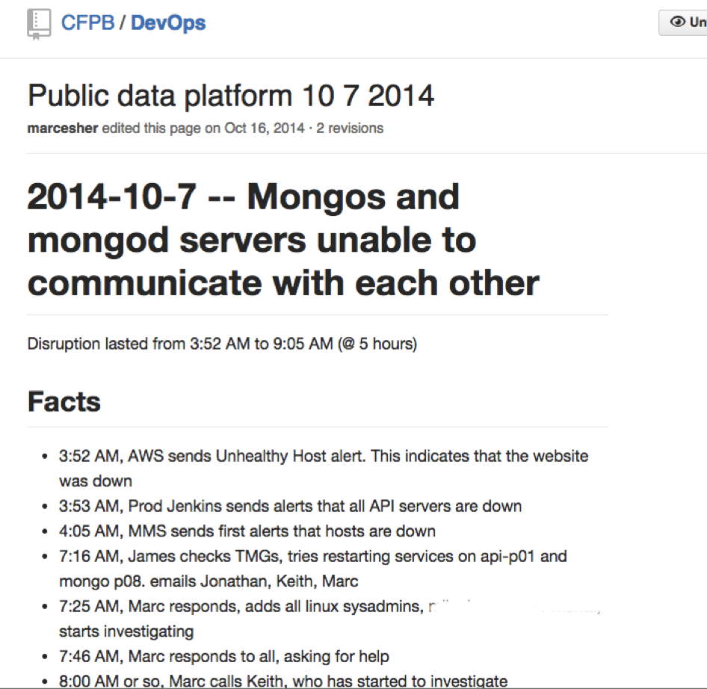
Notes:
First thing we do is start a wiki page

Slide 79
Accountability = Tell Your Account
Notes:
1. Fact find. Accountability == "Tell your account"
1. this is the single most important part. You can not solve problems if you don't fully understand their context
1. Uncover assumptions the team had... try to dig into multiple perspectives... that's the only way to more fully establish context

Slide 80
Identify systemic pressures
Notes:
Identify systemic pressures -- Where did the system increase the likelihood of a problem or prevent faster time to recovery

Slide 81
Team owns the solutions
Notes:
1. Team makes concrete suggestions for improvements, who's accountable, by when
1. Get those into an issue tracker for scheduling and implementation

Slide 82
Why blameless?
Notes:
### Why bother?
- Why not just fix the problem and move on
- Frankly... that's how it is in many organizations
- or a slight variant: Who screwed up, and how can we prevent him from screwing up again (or how can we get rid of this bad apple)
And, quite frankly, we still do this with our technical systems. We have so much work to do here. But we’ve started it
- We work on complex, or at least nontrivial, systems:
- our hosting provider is the brainchild of thousands of architects, network engineers, and developers
- our operating system... tens of thousands
- our web and database servers... thousands
- our programming languages... hundreds to thousands
- our network... hundreds to thousands
- our configuration management and deployment tools... thousands
- our own custom software... hundreds
- Our systems are the result of perhaps 100+ thousand people, over decades
- To think that everything will generally "just work", all the time, is not only wishful thinking, it's also dangerous
- The best offense we have to tame that complexity is learning
- yes, more sophisticated automation and tooling is important.
- But nothing -- nothing! -- is more effective than our humans
- And the way we learn is to commit to learning as a goal, to create conditions for it (i.e. blameless postmortems),
and to implement its practices habitually, from the smallest disruption to the largest

Slide 83


Slide 84
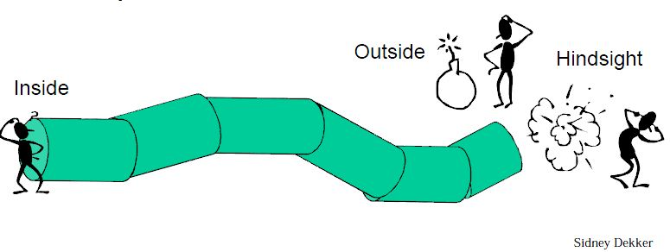

Slide 85
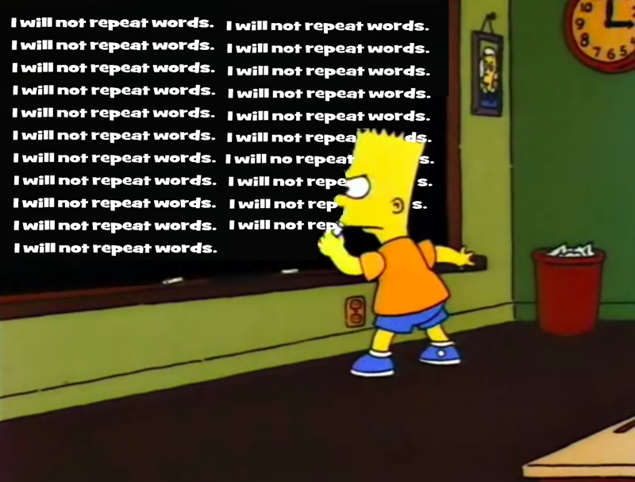
Notes:
http://www.spencerbrokaw.com/2012/06/guest-post-from-author-rob-guthrie.html
This pattern of failure, response, resolution plays out over and over again, every single day, in our organization and every other organization, in all manner of systems.
It’s obviously not isolated to technical systems.
This pattern applies to every single one of you in here because you work on a team, in an organization, with other humans and systems
The nice thing about technical incidents like this one is that they compress timelines very tightly so they’re useful as a way of exploring failure and response to failure

Slide 86
“Learning Culture” at the Sharp End
Notes:
If you want to see how well that message about building a learning organization is flowing down to the Sharp End of the organization – the boots on the ground, the implementers – look at how the sharp end approaches failure.
I implore all of you, when faced with what is surely inevitable failure, to commit as a team to respect one another, to learn from it, to share that learning, and feed it back into the organization so that we collectively get better.
The alternative, by the way, is terrible and heartbreaking: it’s learned helplessness. When the people at the sharp end are faced with a failure and their response, after it’s fixed, is “Oh, I don’t know what they did, but they fixed it, and I guess we’ll hope it doesn’t happen again”… that’s helplessness. Or when it’s “yeah, this thing was awful, but there’s nothing we can do”, that’s helplessness.
Learning from failure is a choice, and that choice rests with each of us

Slide 87
Resources
http://humanedevelopment.org
http://multipliersbooks.com/
http://multipliersbooks.com/wp-content/uploads/2017/05/Multipliers-Minimizing-Accidental-Diminisher-Tendencies-May-2017.pdf
http://freakonomics.com/podcast/in-praise-of-maintenance/
http://freakonomics.com/podcast/gender-barriers/
https://www.nytimes.com/2016/02/28/magazine/what-google-learned-from-its-quest-to-build-the-perfect-team.html
https://rework.withgoogle.com/blog/how-to-foster-psychological-safety/
https://codeascraft.com/2012/05/22/blameless-postmortems/
https://codeascraft.com/2016/11/17/debriefing-facilitation-guide/
http://www.amazon.com/Field-Guide-Understanding-Human-Error/dp/0754648265
http://lessonslearned.faa.gov/ll_main.cfm?TabID=3&LLID=59
https://hbr.org/2011/04/strategies-for-learning-from-failure
http://charlesduhigg.com/the-power-of-habit/
http://www.axialent.com/uploads/paper/archivo/A%20Conscious%20Case%20for%20Diversity%20and%20Inclusion%20_%20Pamela%20Mattsson.pdf
https://hbr.org/2013/12/how-diversity-can-drive-innovation
https://www.linkedin.com/pulse/diversity-moral-imperative-just-business-rob-cahill
http://www.boykiemackay.com/productivity/10-years-of-experience-or-1-year-repeated-10-times/
http://blog.jessitron.com/2017/06/the-most-productive-circumstances-for.html
https://hbr.org/2013/05/your-optimism-might-be-stifling-your-team
https://www.youtube.com/watch?v=MzTNMalfyhM

Slide 88
My favorite relevant Twitter-ers
https://twitter.com/marcesher/lists/multipliers

Slide 89
Final thoughts…
Notes:
Managers: it is one of your most important jobs to help develop other people. I want you to examine your own tendencies to be a multiplier, or an accidental diminisher
For those who consider yourselves more senior, more experienced, maybe you’re a team lead… do the same! You’re a mentor, a sponsor. Your impact is more than just about the code you write. If you want to be a 10X developer, grow 10 people!
For those earlier in their careers: you’re the future. We need your energy and curiosity and passion and grit. We also need you to be grateful for feedback and open yourself up to the experience of others. Expect to be challenged in really uncomfortable ways and dig deep inside to rise to those challenges. And, of course, all of this multiplier and diminisher stuff applies to you, too!
For all of you: I hope when you think about your career, your legacy, that you can look back and be proud of the software you wrote. You study, practice, attend great conferences like this and learn all the cool stuff, and that’s fantastic. But what I really hope is that when you look back, you can say that you helped build great teams and great organizations, and that the impact you had was not just that you built great software, but that you helped other humans grow

Slide 90
Thanks!
cf.Objective() 2017
Marc Esher
@marcesher
https://marcesher.com

